Slide 1
Lecture №3
Cell organelles. The structure of the Membrane bound organelles and their functions.

Slide 2
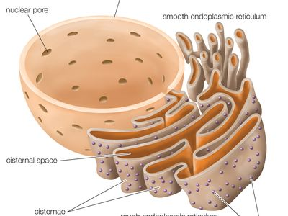
Endoplasmic reticulum
In eukaryotic cells endoplasmic reticulum is generally the largest membrane which forms extensive system of intercommunicating membranous sacs or channels. It represents 30 to 60% of total membrane in a cell. The membrane of endoplasmic reticulum may or may not have ribosomes attached to their outer membrane.
Accordingly these are classified as rough (RER) or smooth endoplasmic reticulum (SER).
Rough endoplasmic reticulum is characterized by the presence of ribosomes and rich in protein and RNA. Smooth endoplasmic reticulum lacks ribosomes. It comprises three types of elements: cisternae, tubules and vesicles

Slide 3
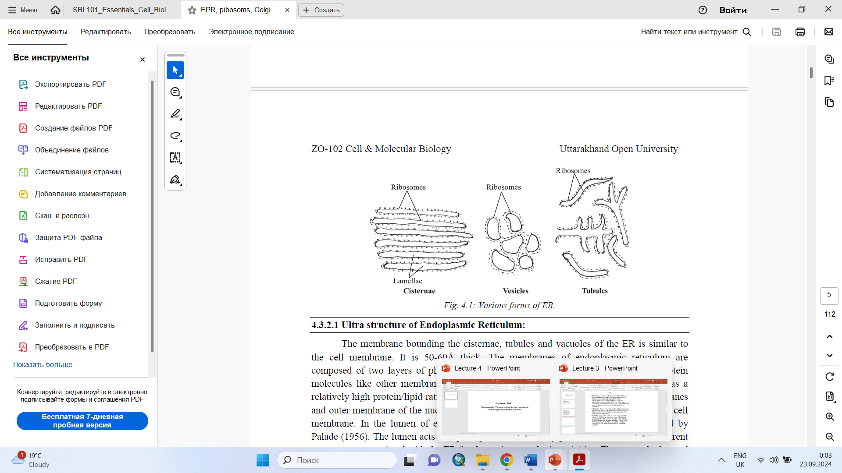
Cisternae- These are flattened, unbranched, sac like elements with about 40-50μm in diameter. They lie in stacks (piles) parallel to but interconnected with one another. They are separated from one another by cytosolic spaces. The small granular structures called the ribosomes may or may not be present on the surface of cisternae.
Tubules- These are irregular, branching elements, which form a network along with other elements. They are about 50-100μm in diameter, and are often free of ribosomes.
Vesicles- These are oval, vacuole like elements, about 25-500μm in diameter. They often occur isolated in the cytoplasmic matrix. They are also free of ribosomes. A fluid called the endoplasmic matrix is present in the lumen of ER. All the elements of ER freely communicate with one another

Slide 4
Smooth Endoplasmic Reticulum:
Ribosomes are absent on the walls of ER and so it appears smooth and hence called smooth or agranular ER. It mainly occurs as tubular forms.
Smooth ER is commonly found in the cells involved in the synthesis of steroids or lipids i.e. non protein type of synthesis such as adrenal or sebaceous glands, gonadial interstitial cells. Certain cells with carbohydrate metabolism (e.g. liver cells), impulse conduction (e.g. muscle cells),with pigment production (e.g., retinal pigment cell) and electrolyte excretion (e.g.,chloride cells of fish gills) are also have more of SER in them.

Slide 5
Rough Endoplasmic Reticulum (RER):
It is characterized by the presence of ribosomes on the surface of reticulum and so it is also known as granular ER.
It is in the form of flattened cisternae.
RER occurs largely in the cells that are actively involved in the synthesis of proteins such as enzymes (e.g. pancreatic cells, plasma cells and liver cells) or mucus (goblet cells). In exocrine cells of pancreas, RER consists of reticular sheets and fenestrated cisternae in the basal region of the cell. In apical region of the cells, granular reticulum occurs in the form of vesicles. Granular and agranular ER are in continuity of their membranes in the regions of contact.

Slide 6
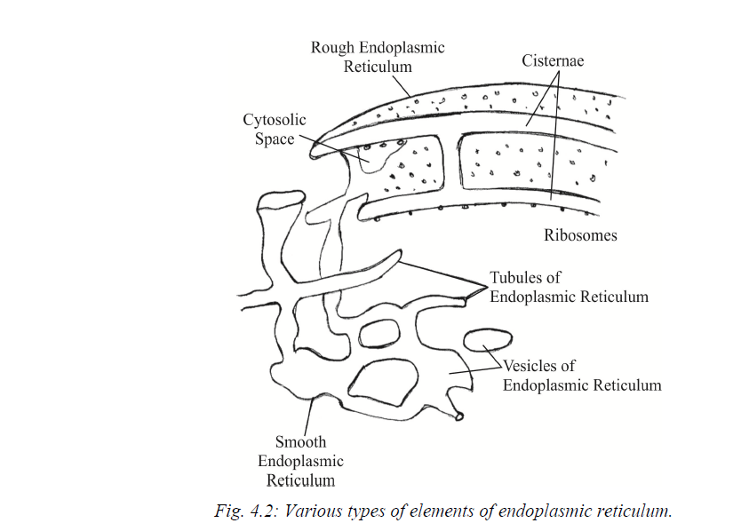

Slide 7
Functions of smooth endoplasmic reticulum
1. Surface for Synthesis- The SER provides surface for the synthesis of fatty acids, phospholipids, glycolipids, steroids and visual pigments.
2. Glycogen Metabolism- The SER carries enzymes for glycogen metabolism in liver cells. Glycogen granules are attached in larger numbers to the outside of the SER’s membranes in liver cells.
3. Detoxification- The SER has enzymes that are involved in the detoxification in the liver, i.e., converts harmful materials such as carcinogens and pesticides, into harmless ones for excretion by the cell.
4. Formation of organelles- The SER produces Golgi apparatus, lysosomes, micro bodies and vacuoles.
5. Transport route- The proteins shift from RER through SER to Golgi apparatus for further processing.
Page 51
6. Skeletal Muscle Contraction- The sarcoplasmic reticulum in skeletal muscle cells release Ca2+ ions to cause contraction and absorbs Ca2+ ions to bring about relaxation.
7. Fat Oxidation- The SER membranes carry out the initial reactions in the oxidation of fats.

Slide 8
Functions of rough endoplasmic reticulum
1.Surface for Ribosomes- The RER provides a large surface for the attachment of ribosomes.
2. Surface for synthesis- The RER offers extensive surface on which protein synthesis can be conveniently carried on by ribosomes. The newly formed proteins may enter the ER membranes, becoming a part of the membrane structure or pass into the ER lumen. The proteins becoming a part of ER membrane eventually move from the ER via membranes of other cell organelles, namely Golgi apparatus, secretary vesicles to become permanent plasma membrane proteins.
3. Packaging- The proteins in ER lumen are processed and get enclosed in spherical membrane bound vesicles which get pinch off from the ER. These vesicles have various fates. Some remain in the cytoplasm as storage vesicles while others migrate to the plasma membrane and expel their contents by exocytosis. Some fuse with Golgi apparatus for further processing of their proteins for storage or release from the cell.
4. Smooth ER Formation- The RER gives rise to the smooth ER by loss of ribosomes.
5. Formation of Nuclear Envelope- The RER forms nuclear envelope around daughter cells in cell division.
6. Formation of Glycoproteins- The process of linking sugars to proteins to form glycoproteins starts in the RER and is completed in Golgi apparatus.

Slide 9
Importance of Endoplasmic Reticulum
1. Transport of Materials- The ER facilitates transport of materials from one part of the cell to another thus forming the cell's circulatory system.
2. Formation of Desmotubule- Tubular extension, called desmotubule, extends through plasmodesmata to make ER continuous in the two adjacent plant cells.
3. Support- The ER acts as an intracellular supporting framework, the cytoskeleton that also maintains the form of the cell.
4. Localization of Organelles- It keeps the cell organelles properly stationed and distributed in relation to one another.
5. Surface for Synthesis- The ER offers extensive surface for the synthesis of a variety of materials.
6. Storage of Materials- The ER provides space for temporary storage of synthetic products such as proteins and glycogen.
7. Exchange of materials- The ER helps in the exchange of materials between the cytoplasm and the nucleus. 8. Location of Enzymes- A variety of enzymes is located in the ER membranes to catalyze the biochemical reactions.

Slide 10
Golgi apparatus
Camillo Golgi in 1898 discovered the Golgi apparatus in the nerve cells of barn owl and cat by metallic impregnation method. After it's discoverer's name, the Golgi apparatus has been variously named as Golgisome, Golgi material, Golgi membranes, Golgi body

Slide 11
Structure of Golgi Bodies:-
Golgi bodies varies in size and form in different types of cells, but they have similar organization in all kinds of cells. For example, it is well developed in secretory and nerve cells, but is rather small in muscle cells. Golgi bodies are compiled as a central stack (pile) of flattened sacs or cisternae and many peripheral tubules and vesicles.
Cisternae - The cisternae vary in number from 3 to 7 in most animal cells and from 10 to 24 in plant cells. These support the cisternae and maintain regular spacing between them. The cisternae may be flat, but are often curved, having a distinct polarity with a convex face towards the cell membrane and concave face towards the nucleus. They are free of ribosomes and have swollen ends. They look like the smooth endoplasmic reticulum and are continuous with it at certain places. All the cisternae have a continuous lumen filled with a fluid.

Slide 12
Tubules- Short tubules arise from the periphery of the cisternae. Some of these enlarge at their ends to form vesicles.
Vesicles- The vesicles lie near the ends and concave surface of the Golgi complex. They are pinched off from the tubules:
Transitional Vesicles: These are the small outgrowths formed from the transitional ER. They migrate to, converge and coalesce to cis face of Golgi, where they form new cisternae.
Smooth Vesicles: These have smooth surface and contain secretions of the cell and so they are also called secretary vesicles. They arise from the ends of the cisternae tubules.
Coated vesicles: These have rough surface and they also arise from the cisternae tubules. They play a role in intracellular traffic of secretary protein molecules. of the cisternae. They are of three types: transitional, smooth or secretary and coated vesicles.

Slide 13
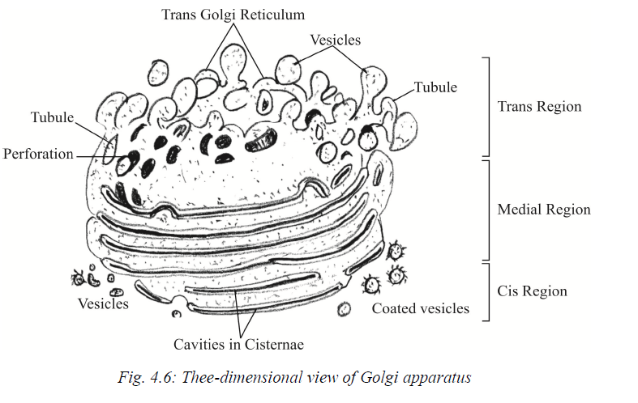
These regions have different enzymes which introduce different modifications to secretary and membrane proteins passing through them. The principal modification is glycosylation, i.e., addition of sugars to proteins, forming glycoproteins. Glycosylation starts in the ER and is completed in the Golgi complex. Modification of proteins in the Golgi apparatus also involves addition of lipids, forming lipoproteins (liposylation), and even the addition of other groups
The Golgi complex has 3 functional regions: cis region that lies nearest the ER, medial region in the middle, and Tran’s region with trans Golgi reticulum nearest to the plasma membrane.

Slide 14
Functions of Golgi Bodies:
Formation of secretary vesicles- The Golgi complex processes and packages proteins and lipids coming from the ER for transport to other parts of the cell or out of the cell. Packaging involves wrapping the materials by a membrane, forming secretary vesicles.
Synthesis of carbohydrates- The Golgi apparatus synthesizes certain mucopolysaccharides from simple sugars.
Formation of Glycoproteins- The Golgi apparatus links the sugars with proteins coming from rough ER to form glycoproteins.
Formation of Lipoproteins- Lipids and proteins coming from the ER are complexed into lipoproteins in the Golgi apparatus.
Addition to Cell Membrane- The Golgi apparatus provides membrane material for the plasma membrane when the later must enlarge for the formation of pinocytotic and phagocytotic vesicles and for the formation of cleavage furrow during the division of animal cells.

Slide 15
Membrane Transformation- The Golgi apparatus changes one type of membrane into another type. Membranes are gradually modified from the ER type to one with characteristics of the plasma membrane as they shift through the Golgi complex.
Formation of cell wall- In some algae, cellulose plates for cell wall is synthesized in Golgi complex. In higher plants the Golgi complex (a) synthesizes pectin and some carbohydrates necessary for the formation of cell wall and (b) produces some secretions such as mucilage, gums, etc.
Formation of lysosomes- The Golgi complex gives rise to primary lysosomes by budding. The lysosomes may also arise from ER.
Formation- The Golgi complex gives rise to the acrosome in a sperm.
Formation of Yolk and Cortical Granules- The Golgi complex produces yolk and cortical granules in the eggs. Formation of yolk is called vitellogenesis.
Storage of Secretions- The Golgi complex
Absorption of Materials- Golgi apparatus absorbs materials from the environment. For example, cells of the intestinal lining use Golgi apparatus to absorb lipids from the intestine.
Location of Enzymes- A variety of enzymes is localized in the Golgi complex to help in the cell's biochemical reactions. stores cell secretions such as proteins and lipids.

Slide 16
Vacuole
A vacuole is a membrane bound structure found in the cytoplasmic matrix of a cell. The membrane surrounding the vacuole is known as tonoplast. The components of the vacuole, known as the cell sap, differ from that of the surrounding cytoplasm. The membranes are composed of phospholipids. The membranes are embedded with proteins that help in transporting molecules across the membrane. Different combinations of these proteins help the vacuoles to hold different materials.
The vacuoles in plant cells are larger than those in the animal cells. The plant vacuoles occupy more than 80% of the volume of the cell. The vacuoles may be one or more in number.

Slide 17
Functions of vacuoles
Storage
A vacuole stores salts, minerals, pigments and proteins within the cell. The solution that fills a vacuole is known as the cell sap. The vacuole is also filled with protons from the cytosol that helps in maintaining an acidic environment within the cell. A large number of lipids are also stored within the vacuoles.
Turgor Pressure
The vacuoles are completely filled with water and exert force on the cell wall. This is known as turgor pressure. It provides shape to the cell and helps it to withstand extreme conditions.
Endocytosis and Exocytosis
The substances are taken in by a vacuole through endocytosis and excreted through exocytosis. These substances are stored in the cells, separated from the cytosol. Lysosomes are vesicles that intake food and digest it. This is endocytosis and it varies in different cells.

Slide 18
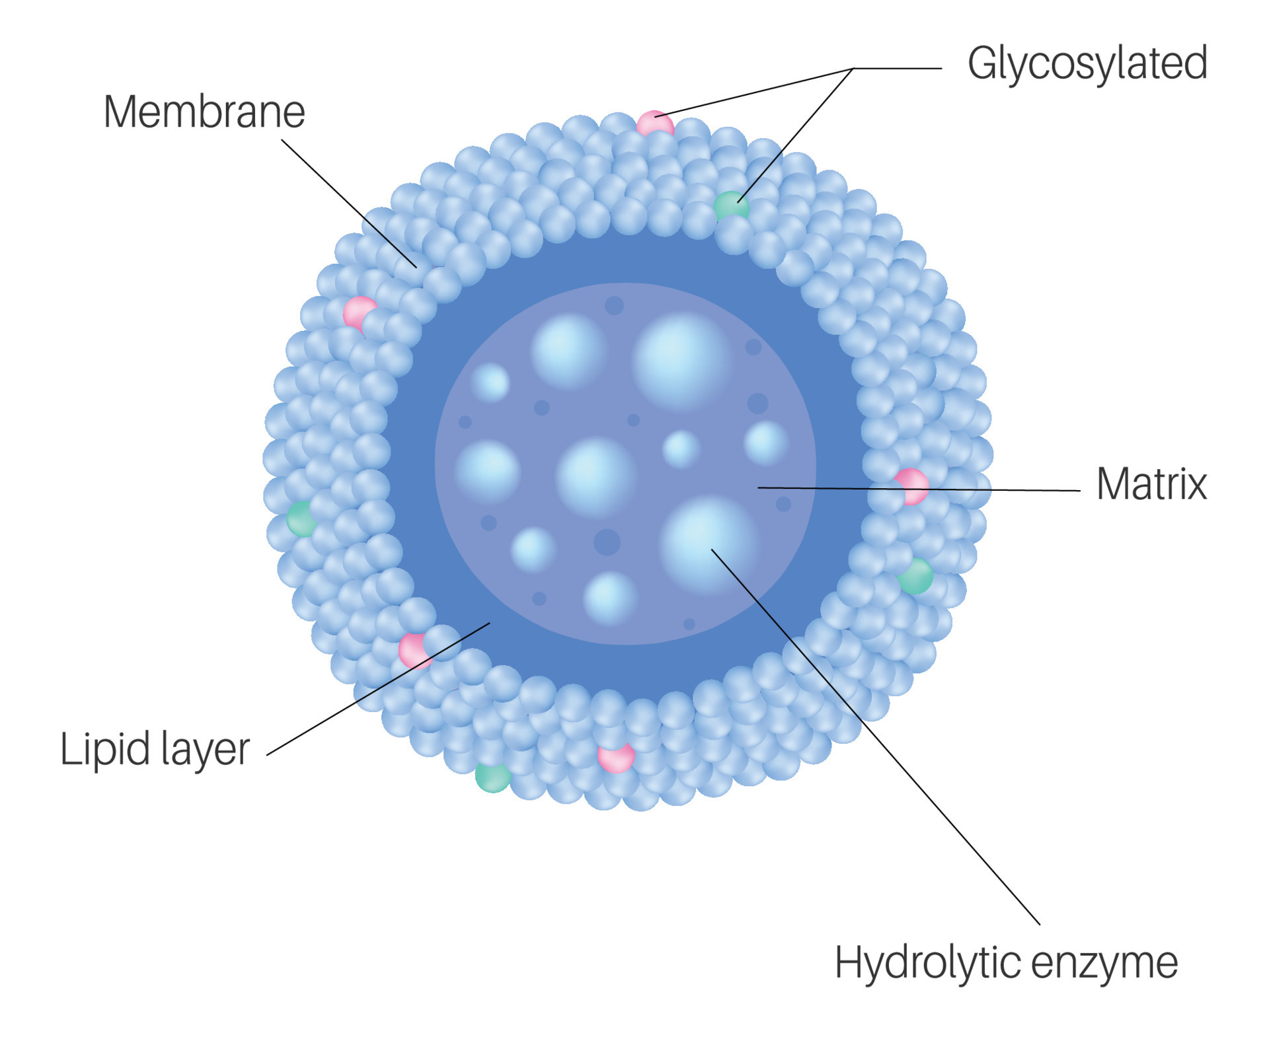
Lysosomes
Lysosomes are round tiny bags filled with dense material rich in acid phosphatase (tissue dissolving enzymes) and other hydrolytic enzymes. They consist of two parts: (i) limiting membrane and (ii) inner dense mass.
Limiting membrane: This membrane is single and is composed of lipoprotein. Chemical structure is homologous with unit membrane of plasmalemma, consisting of bimolecular layer.
Inner dense mass: This enclosed mass may be solid or of very dense contents. Some lysosomes have a very dense outer zone and a less dense inner zone. Some others have cavities or vacuoles within the inner granular material. Lysosomes are of various types and they help in intracellular digestion. Their contents vary with the stage of digestion.

Slide 19
There are four types of lysosomes: primary, secondary, residual bodies and cytolysosome or autophagosome.
1. Primary Lysosome (storage granules): It is a small sac like body. Its enzymatic contents are synthesized by ribosomes and accumulated in ER. From there, they enter the Golgi region, where acid phosphatase reaction takes place. The primary lysosome comprises only one type of enzyme or another.
2. Secondary Lysosome (digestive vacuole or heterophagosome): These are produced either from phagocytosis or pinocytosis of foreign material by the cell. Actually within the cell, after phagocytosis or pinocytosis, the foreign bodies or extra-cellular substances are enclosed within the membrane and these membranes bound structures are known as phagosome or pinosomes. These ultimately fuse with pri
3. Residual bodies: These are formed in case the digestion is incomplete. In some cells, such as Amoeba and other protozoa, these residual bodies are eliminated by defecation. Hence, lysosomes having undigested material or debris are called residual bodies. These bodies are formed due to lack of certain enzymes in lysosomes. These residual bodies also cause diseases in man such as fever, hepatitis, polynephritis, hypertension, congested heart failure etc.

Slide 20
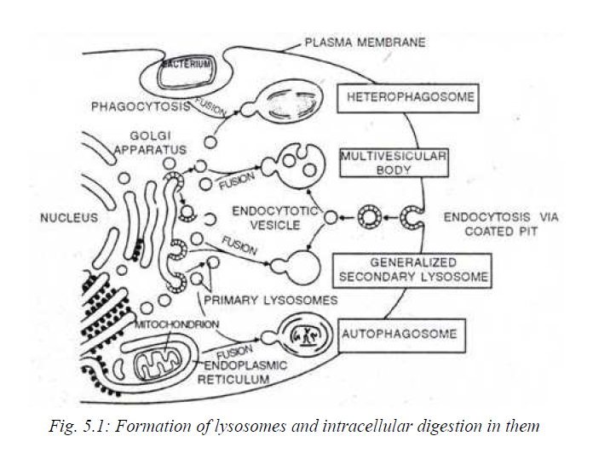
4. Autophagic vacuole (cytolysosome or autophagosome): In this case, the lysosome digests a part of cell (e.g., mitochondria or portion of ER) by the process of autophagy. For example, liver cell shows numerous autophagosome during starvation among which remnants of mitochondria occur. This is a mechanism by which the cell can achieve degradation of its own constituents without irreparable damage

Slide 21
Chemically lysosomes are defined as a body rich in acid hydrolases. Acid phosphatase has been found in many cells of plant roots, fungi, liver, kidney and endocrine glands. The lysosomal enzymes can break down all major biological macromolecules present in the cells or entering the cells from outside into their building block subunits by adding water. The common enzymes in the lysosomes are proteases, nucleases (deoxyribonuclease and ribonuclease), glycosidase, lipases, sulphatases and phosphatase, which hydrolyses proteins, nucleic acids, polysaccharides, lipids, organic sulphatases and organic phosphates respectively.

Slide 22
Functions of lysosomes
Digestion of useful materials: Intracellular digestion is a regular feature in protozoans and in lower invertebrates such as sponges and coelenterates. In this process the organic substances (food particles) taken up by the cells in vacuoles (pinosomes or phagosome) from the environment are digested.
Digestion of harmful materials: The foreign particles, such as viruses, bacteria and toxic molecules, are disposed of by hydrolyzing them in certain leucocytes and macrophages. This is called natural defense of the body. This activity of lysosomes is characteristic of higher animals.
Digestion of unwanted materials: The dead cells and debris that accumulate at the sites of injury are destroyed in some white blood cells. This is called natural scavenging of the body.
Renewal of cells and organelles: The old worn out cells and cell organelles are broken down to make the component molecules available for formation of new cells and cell organelles. Thus, the lysosomes facilitate the turn-over of cells in normal tissues and of organelles in normal cells.
Feeding of starving animals: Food to a starving animal is provided by digesting the stored food materials (proteins, lipids and glycogen) and even the cells. This is called autophagy.
Autolysis: Autolysis caused by the lysosomal enzymes plays a role in normal developmental changes in both animals and plants. E.g., in the breakdown and absorption of tail during the metamorphosis of frog's tadpole. In autolysis, lysosome membrane ruptures and releases the enzymes into the surrounding cytoplasm. This kills and lyses the cell.
7. Aid in fertilization: The lysosome of sperms releases their enzymes to dissolve the egg membranes for the entry of the sperm into the ovum in fertilization. This is called extracellular digestion.

Slide 23
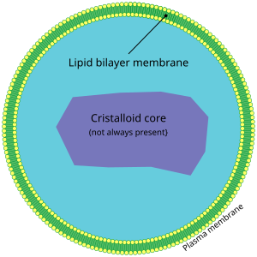
Peroxisome
Peroxisomes are small vesicles, single membrane-bound organelles found in the eukaryotic cells. They contain digestive enzymes for breaking down toxic materials in the cell and oxidative enzymes for metabolic activity. They are a heterogeneous group of organelles and the presence of the marker enzymes distinguished them from other cell organelles.
Peroxisomes play an important role in lipid production and are also involved in the conversion of reactive oxygen species such as hydrogen peroxide into safer molecules like water and oxygen by the enzyme catalase.

Slide 24
Peroxisomes vary in shape, size and number depending upon the energy requirements of the cell. These are made of a phospholipid bilayer with many membrane-bound proteins.
The enzymes involved in lipid metabolism are synthesised on free ribosomes and selectively imported to peroxisomes. These enzymes include one of the two signalling sequences- Peroxisome Target Sequence 1 being the most common one.
The phospholipids of peroxisomes are usually synthesised in smooth Endoplasmic reticulum. Due to the ingress of proteins and lipids, the peroxisome grows in size and divides into two organelles.

Slide 25
Functions of Peroxisomes
They take part in various oxidative processes.
They take part in lipid metabolism and catabolism of D-amino acids, polyamines and bile acids.
The reactive oxygen species such as peroxides produced in the process is converted to water by various enzymes like peroxidase and catalase.
In plants, peroxisomes facilitate photosynthesis and seed germination. They prevent loss of energy during photosynthesis carbon fixation.

